Slide 1


CAPSTONE PROJECT
PROJECT TITLE
Presented By
Student Name: Diksha
College Name: amity university Rajasthan
Department: B.TECH (CSE)
Email ID: 3d5iksh@gmail.com

Slide 2
OUTLINE:
Problem Statement (Should not include solution)
Proposed System/Solution
System Development Approach (Technology Used)
Algorithm & Deployment
Result (Output Image)
Conclusion
Future Scope
References

Slide 3
Problem Statement:
Modern digital entertainment industries generate a massive amount of data related to viewer preferences, anime popularity, genres, studios, and ratings. However, this information is often scattered across multiple platforms, making it difficult to analyze trends and derive insights.
Anime fans, producers, and analysts require a centralized system that can visualize key metrics such as popularity, ratings, episode counts, genre distribution, and production studios. Without proper data visualization tools, identifying trends in the anime industry becomes time-consuming and inefficient.
Therefore, there is a need for a data analytics system that can transform raw anime data into interactive visual insights.

Slide 4
Proposed Solution:
The proposed solution is to develop an interactive Anime Industry Analytics Dashboard using Microsoft Power BI.
The system collects anime dataset information including titles, ratings, genres, popularity scores, episode counts, and production studios. Using Power BI’s data visualization capabilities, the data is transformed into meaningful charts and KPIs.
Key components of the system include:
Data Collection Anime dataset containing information about anime titles, genres, ratings, popularity, studios, and episode counts.
Data Preprocessing Cleaning the dataset by removing missing values, correcting inconsistencies, and organizing columns.
Data Visualization Creating interactive dashboards that display key insights such as:
Total Anime Titles
Average Ratings
Top Popular Anime
Media Type Distribution
Top Production Studios
Genre Analysis

Slide 5
System Approach:
The system was developed using data analytics and visualization tools.
System Requirements
Hardware Requirements
Processor: Intel i3 or above
RAM: 4GB or higher
Storage: 2GB free space
Software Requirements
Microsoft Power BI Desktop
Microsoft Excel / CSV dataset
Windows Operating System

Slide 6
Algorithm & Deployment:
Data Input Anime dataset containing title, genre, rating, popularity score, episode count, media type, and production studio.
Data Processing
Import dataset into Power BI
Clean and organize data
Create calculated measures and KPIs
Prepare data model for analysis
Visualization Algorithm (Analytical Flow)
Load dataset
Process and structure the data
Generate KPIs (Total Anime, Average Rating, etc.)
Create charts for popularity, genre, and studio analysis
Design interactive dashboard
Deployment
Dashboard created using Microsoft Power BI Desktop
Reports can be published to Power BI Service
Users can interact with filters and visual insights.

Slide 7
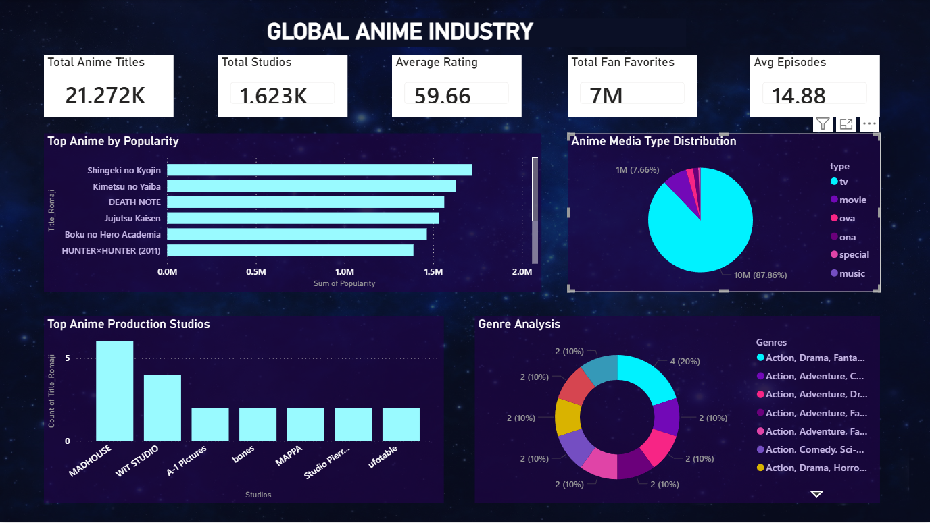
Result:
Data Preprocessing using Power BI Query Editor:
The developed Power BI dashboard successfully visualizes key insights from the anime dataset. It displays important metrics such as total anime titles, average ratings, top popular anime, genre distribution, and leading production studios. The dashboard enables users to easily analyze trends and patterns in the anime industry through interactive visualizations.

Slide 8
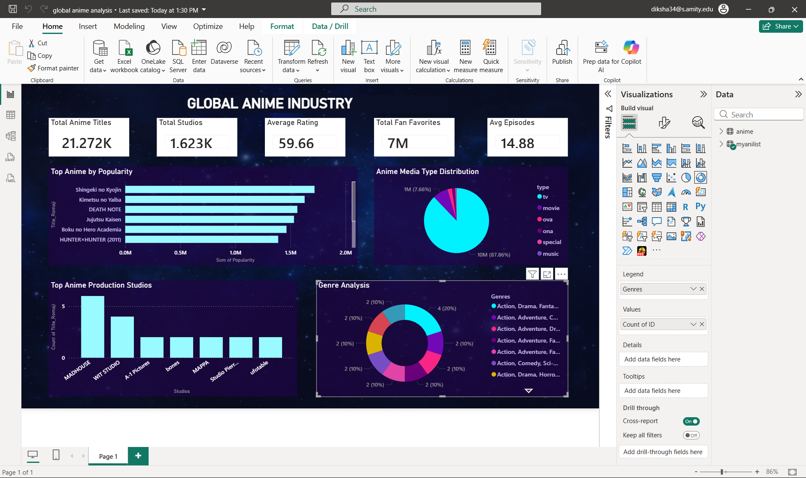

Slide 9
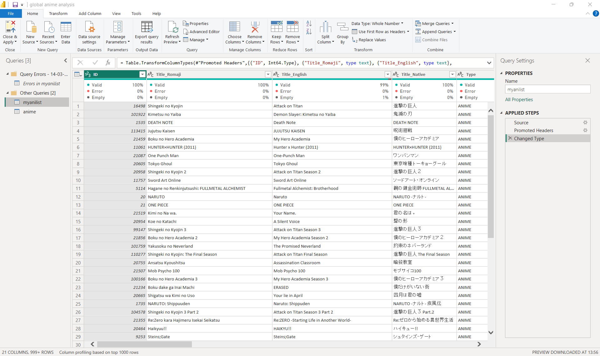
Data Preprocessing:
The anime dataset was imported into Power BI and cleaned using the Power Query Editor. Data types were corrected, missing values were handled, and irrelevant rows were filtered. This preprocessing step ensures that the dataset is structured and ready for accurate analysis and visualization.

Slide 10
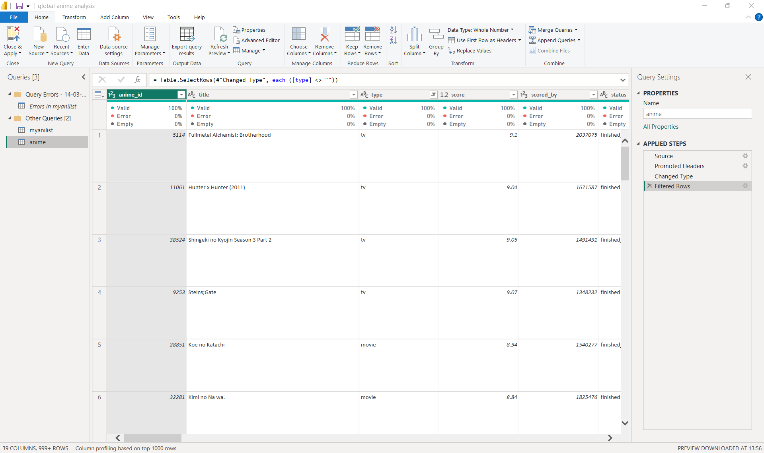
Dataset Structure:
The dataset contains important anime information such as title, genre, type, rating score, popularity, and user engagement. These attributes are used to generate key performance indicators and visual analytics in the dashboard.

Slide 11
Conclusion:
The Anime Industry Analytics Dashboard demonstrates how data visualization tools like Power BI can transform raw datasets into meaningful insights.
The system successfully analyzes anime industry data and presents it in an interactive and user-friendly dashboard format. Users can easily identify trends such as popular anime titles, dominant genres, and leading production studios.
This project highlights the importance of data analytics in understanding entertainment industry trends and supporting better decision-making.

Slide 12
Future scope:
The project can be further enhanced with additional features:
Integration of real-time anime streaming platform data
Predictive analysis of anime popularity using machine learning
Sentiment analysis of fan reviews from social media
Expansion of the dashboard to include global anime market trends
Deployment as a web-based analytics application
These improvements would provide deeper insights into the anime industry.

Slide 13
References:
MyAnimeList Anime Dataset
Microsoft Power BI Documentation
Kaggle Anime Dataset
Data Visualization Best Practices
GitHub Link:

Slide 14
Thank You

